Slide 1

Lesson 6: The SEO Consulting Process
Kubilay Cagatay
WEB 225

Slide 2

Selling the client – Getting them to care
Clients need to see value in using you as an SEO consultant
Essentially…. Why should they spend money on you?
Consultants need to make a strong case for themselves to win the business. How could you do that?

Slide 3

1. Point out how essential your services could be!
Don’t lose customers: When searching for a product or service, 75% of potential customers start by using a search engine
Targeted: SEO traffic is targeted to potential customers who are ready to buy
Cost effective: SEO consulting can be up to 14x cheaper than pay-per-click campaigns

Slide 4


2. Be prepared to sell yourself
Focus: Show you will have laser vision. Show you won’t get distracted by other clients or other activities
Stay current: Be up-to-date on industry trends
Under-promise + over-deliver: Give yourself cushion with any predictions you give with how much their traffic will improve

Slide 5
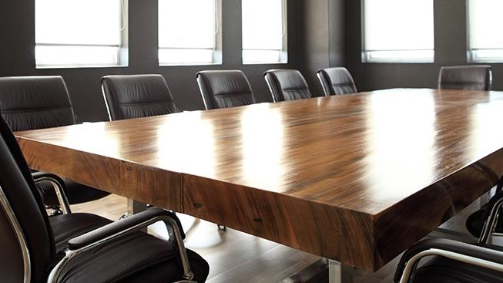
3. At the first meeting
Survey: Learning about the client and ask what they want out of the services
Consider: Explain the process/background if they are curious, otherwise for some clients, a summary can suffice
Set expectations: Agreements such as the “Master Service Agreement”, “Nondisclosure Agreement” and “Statement of Work” should be gone over and agreed upon

Slide 6

4. Setting price points
Experience level: What you charge can be dependent on your skills and reputation
Some other fees:
Website Audit
Link Building
Social Media Management
Keyword Research
Freebies:
Lunch meetings where you can make valuable connections
Emails
Wrap-up/Follow-up Meetings

Slide 7
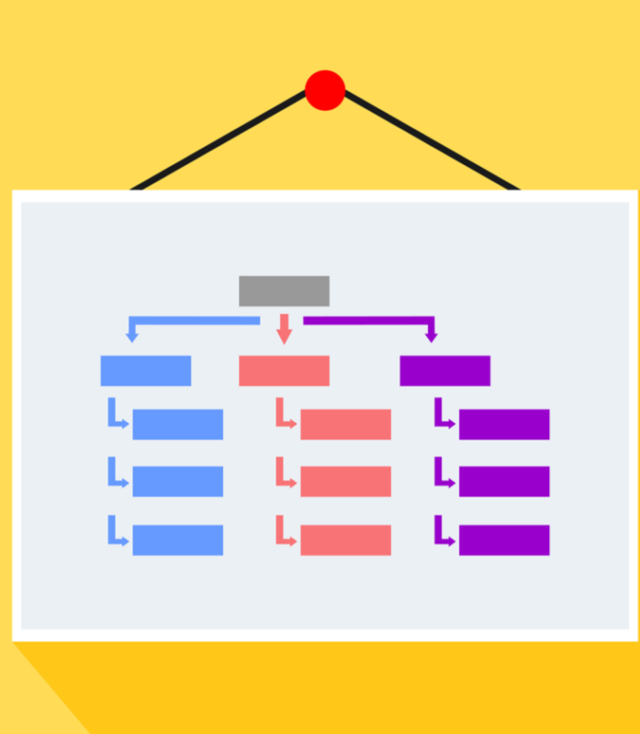
5. Deliverables to offer
Quick hit list: quick changes that provide the most SEO value
Fix global navigation
Implement SEO friendly information architecture
Add a sitemap

Slide 8
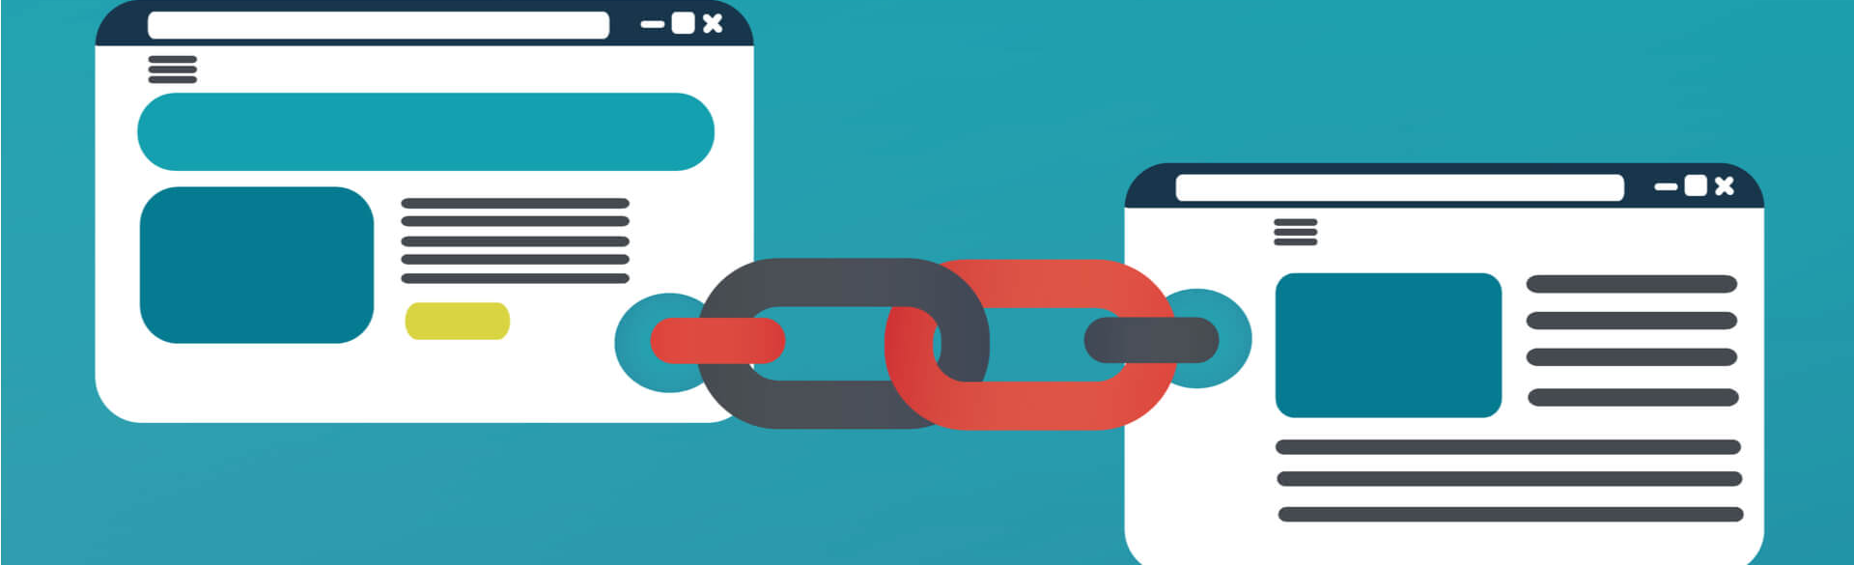
5. Deliverables to offer (continued)
Quick hit list: quick changes that provide the most SEO value
Implement better internal linking
Redirect duplicate content
Implement link building techniques

Slide 9

6. Follow-up
After completing the work, make sure you meet with the client to ensure you met expectations
Can teach you a lot about the effectiveness of your strategies as well

Slide 10
Thank you!

